Slide 1
Electrical

Slide 2
Computers
Main Computer
Intel i7 processor
6GB RAM
USB, Firewire, Serial
Microcontrollers
The design of a custom daughter allowed us to replace the previous 4 arduinos that responsible for motor control and encoder reading with a single arduino.
A second arduino is used for controlling lights and various other ancillary systems on the robot

Slide 3
Sensors
Reused Sensors
LIDAR
SICK
GPS
NAV200
New Sensors
Stereo Camera
Bumblebee2
9 DOF IMU
Ardupilot
Encoders
US Digital

Slide 4
Power
Source
2 12v lead-acid batteries
Total energy capacity of 1052 Watt-Hours
~1 Hour of motor run time
Distribution
3 different voltage rails
24v, 12v, 5v
First two provide power to sensors and motors
Last of these provides power to USB hub

Slide 5
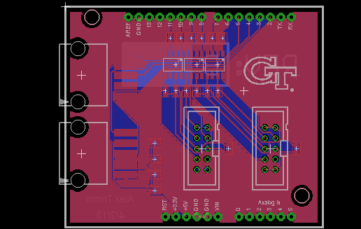
Daugter Board

Slide 6
Software

Slide 7
Overview
Summary of this year's work
Architecture
Major Algorithms
Vision
Mapping
Path Planning
Controls
Sensor Integration

Slide 8
This year's work - All new everything
This year's software team had 0 returning members.
The existing codebase had been used and modified over the course of approximately 5 years.
Additionally, the existing codebase was formed around a purely responsive system. Future competitiveness would require transitioning a more sophisticated approach
Solution: Complete Rebase

Slide 9
Architectural Approach
The first major task we faced was attempting to decide on an overarching approach to creating the software system necessary for the competition.
We wished to follow good object-oriented design principle

Slide 10
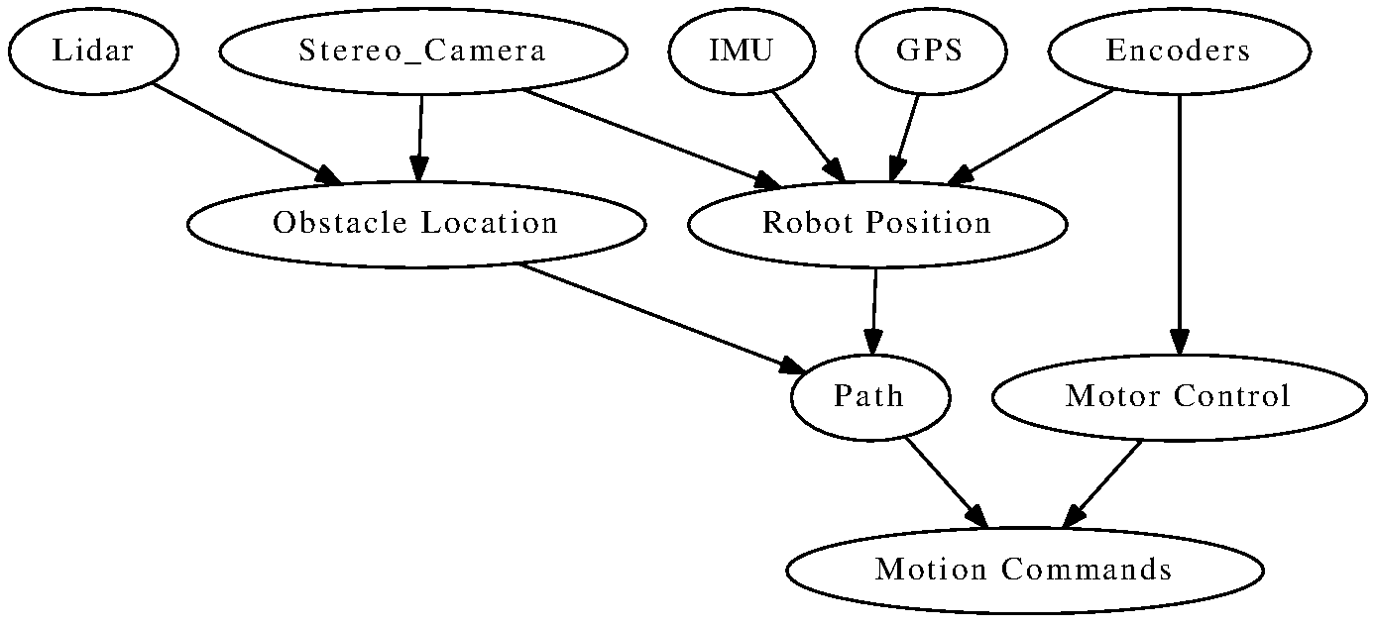
Architecture and Design

Slide 11
Design
Extensive use of Interfaces and Inheritance to ensure consistency and simplicity.
All sensor data inherits from a common class providing timing information
Event/Listener design paradigm used to facilitate communication between functional units of the system
Allowed rapid substitution of algorithms
System was leveraged to allow for the creation of sensor simulators to allow easy testing in lab.

Slide 12
Vision
This year's software made extensive use of the OpenCV library
Major Vision Algorithms
Lane Detection
Utilizes Lidar data to remove potential distractors
Visual Odometry
Uses IMU data to provide update statements over fixed periods of time
Provides a means of lessening uncertainty present in GPS data

Slide 13
Path Planning
Our robot employs a version of A* path planning...with a twist.
Normal A* makes the assumption that the robot effectively has a holonomic drive.
To account for this not being the case for most robots, path smoothing algorithms are used to provide more natural motion.
Our modified A* uses more natural robot motions as state changes and a heuristic that penalized time-inefficient decisions such as turning in place.

Slide 14
Sensor Fusion
The multiple additions of sensors used this year brought with it the question of how to use overlapping and possibly contradicting data.
Our Decision: implement a Kalman Filter
Brought on additional complexity of trying to determine appropriate parameters for each fused data type.
Fairly simple for sensors such as GPS
More complex for alternative data sources such as our visual odometry algorithm

